Slide 1
Udacity Connect Session
May 19, 2018
Project/Proposal

Slide 2
Welcome back!

Slide 3
Morning Schedule
10:00 - 10:30 | Housekeeping, P5 Review
10:30 - 11:00 | Capstone Discussion
11:00 - 12:00 | Work on P5
© 2016 Udacity. All rights reserved.

Slide 4
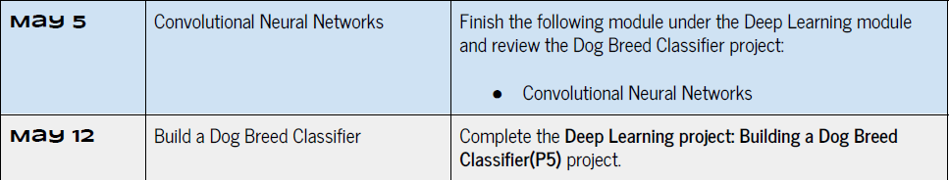

Slide 5
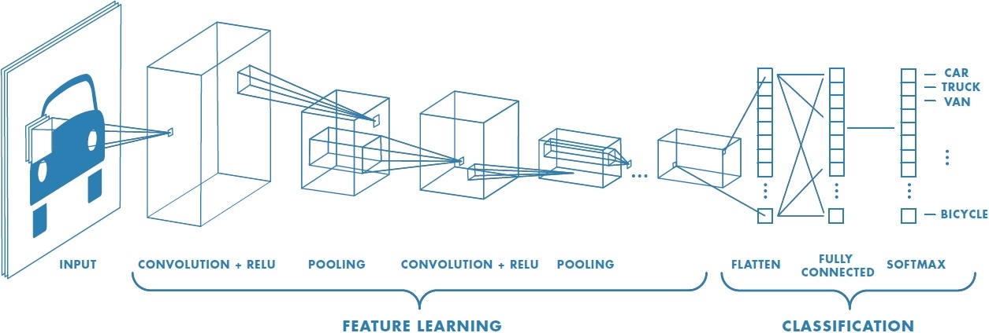
CNN Architecture

Slide 6
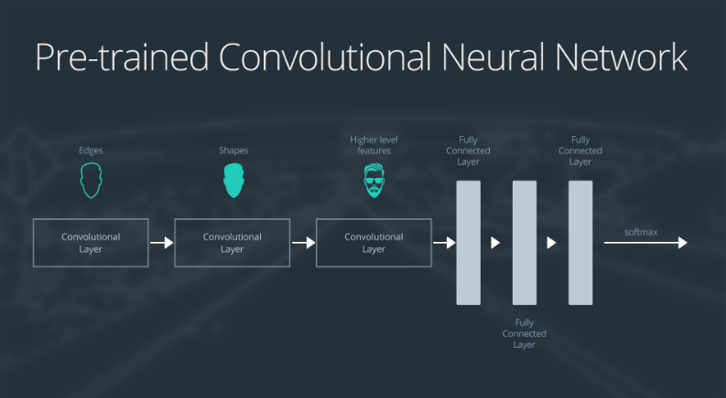
Softmax
Edges
Shapes
Complex Features
FC (Dense) Layers

Slide 7
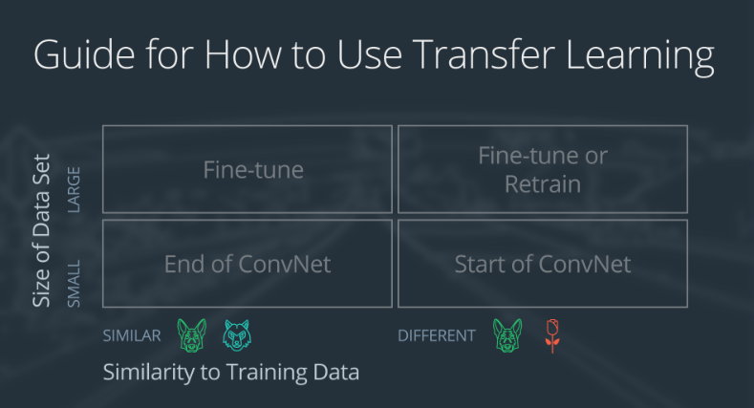

Slide 8
Small data set, similar to original training data
slice off the end of the neural network
add a new fully connected layer that matches the number of classes in the new data set
randomize the weights of the new fully connected layer; freeze all the weights from the pre-trained network
train the network to update the weights of the new fully connected layer

Slide 9
Small dataset similar to training data
Extract
Retrain
Softmax
Edges
Shapes
Complex Features
FC (Dense) Layers

Slide 10
Small data set, not similar to original training data
slice off most of the pre-trained layers near the beginning of the network
add to the remaining pre-trained layers a new fully connected layer that matches the number of classes in the new data set
randomize the weights of the new fully connected layer; freeze all the weights from the pre-trained network
train the network to update the weights of the new fully connected layer

Slide 11
Small dataset NOT similar to training data
Extract
Retrain
Softmax
Edges
Shapes
Complex Features
FC (Dense) Layers

Slide 12
Small data set, not similar to original training data
remove the last fully connected layer and replace with a layer matching the number of classes in the new data set
randomly initialize the weights in the new fully connected layer
initialize the rest of the weights using the pre-trained weights
re-train the entire neural network

Slide 13
Work on Project 5
Capstone Proposal

Slide 14
Lunch Break

Slide 15
Afternoon Session
1:00 - 1:30 | Capstone Proposal Template
2:00 - 2:50 | Capstone Proposal or P5
2:50 - 3:00 | Recap, Lookahead and Feedback
3:00 - 5:00 | Work on Projects (P5, Proposal)
© 2016 Udacity. All rights reserved.

Slide 16
Work on projects
P4 Smartcab
P5 Dog breed
Capstone proposal

Slide 17
Prep for next session
Complete Dog breed Project (P5) due 5/19/18
Prepare 10 min presentation of capstone 6/2/18
Capstone proposal due 6/2/18
No class next week (5/26/18) -- Memorial Day

Slide 18
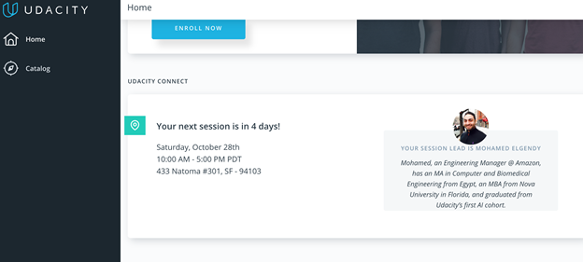
We really need your Feedback!
© 2016 Udacity. All rights reserved.

